Slide 1



PYTHONBRIDGE AFRICA
Learn Python. Build Solutions. Create Opportunities.
Founder
By Chan Gatwech
01

Slide 2

Problem Statements
Youth unemployment
Lack of practical skills
Difficulty learning Python
Limited access to technology
10

Slide 3

Solutions:
Job Connections: Link youth to jobs, internships, and freelance work.
Practical Training: Provide hands-on coding projects and mentorship.
Guided Learning: Offer simple Python lessons and beginner support.
Affordable Technology: Partner with organizations to provide laptops, internet, and learning resources.
06

Slide 4
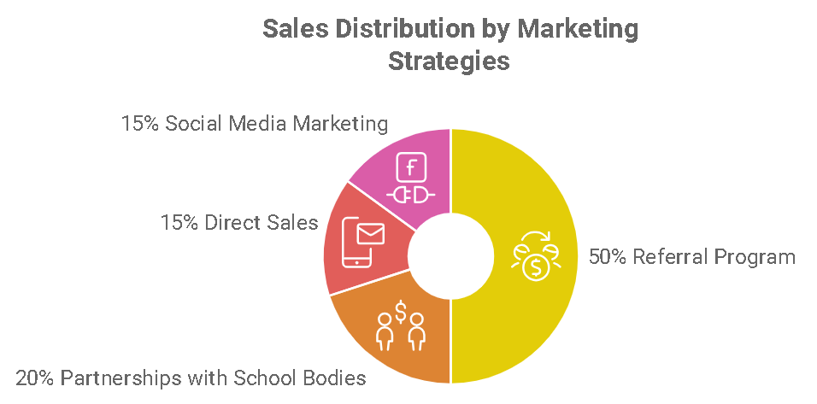
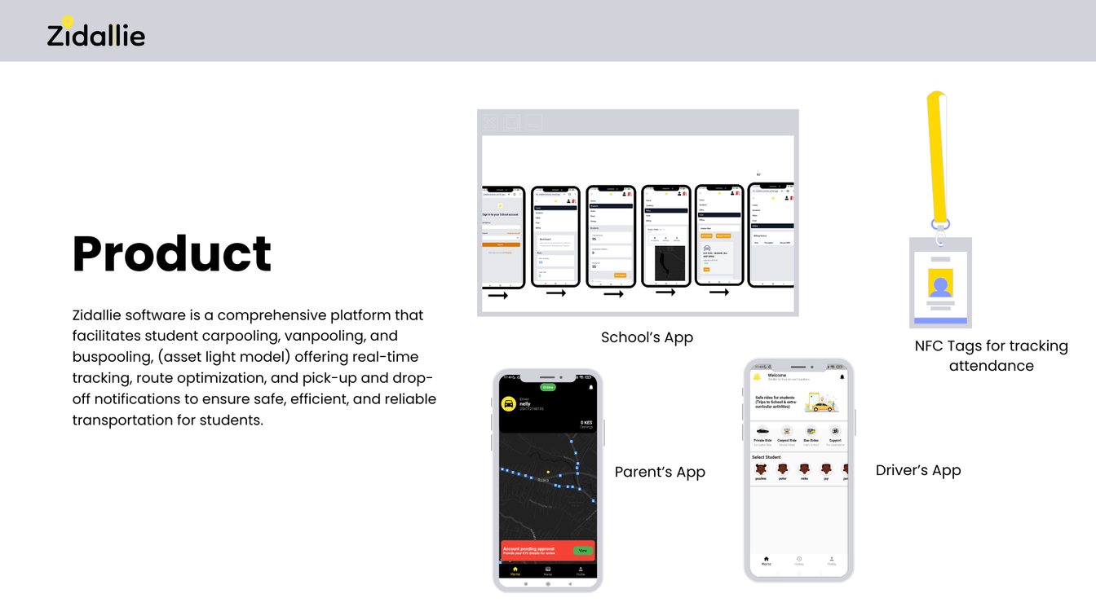
Python Learning Platform
Online Python courses and tutorials for beginners.
Product
Coding Projects:
Practical projects to help youth gain experience.
Project Portfolio
A platform for learners to showcase their coding skills.
04

Slide 5



Target Market
4 OUT 8
Youth face barriers to tech opportunities
Many young people struggle to access practical coding skills and technology jobs.
50%
Digital skills development
PythonBridgeAfrica aims to make Python learning and practical training more accessible.
3 million
Potential youth opportunities
Our vision is to expand digital skills and career opportunities for young people across Africa.
14

Slide 6
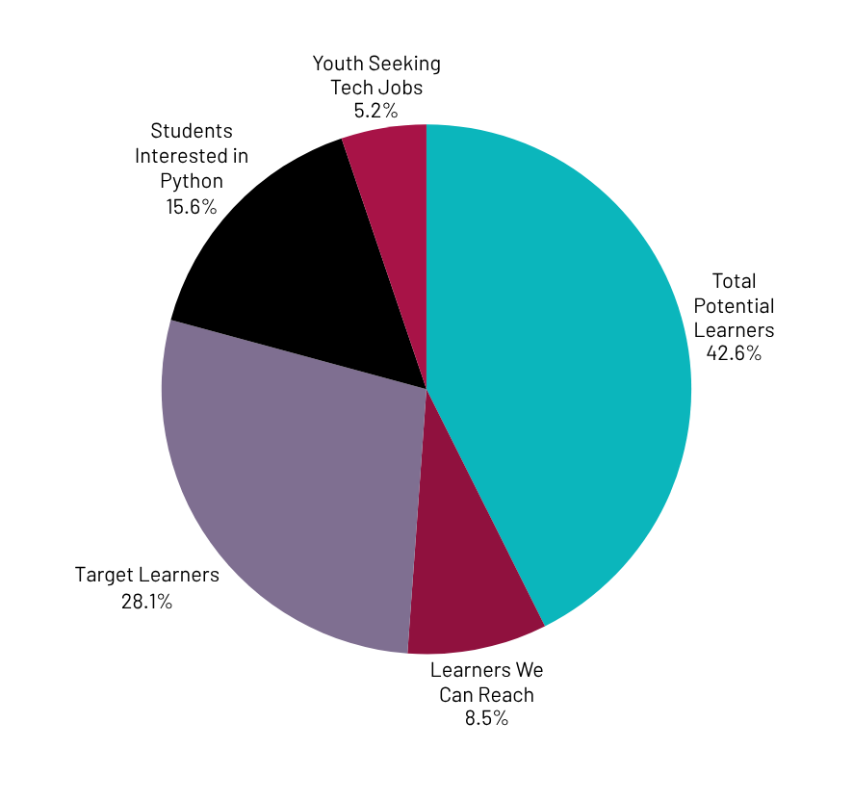
Market Size
Total Potential Learners: 5 Million
Learners We Can Reach: 1 Million
Target Learners: 100,000

Slide 7

Competitors
Competitors: freeCodeCamp, Coursera, and Moringa School.
Our Difference: PythonBridgeAfrica combines beginner-friendly Python training, practical coding projects, mentorship, and career connections in one platform, focusing on helping African youth turn digital skills into employment opportunities.
23

Slide 8



Competitive Advantage
PythonBridgeAfrica
Helps African youth learn Python, gain practical coding experience, receive mentorship, and connect with jobs and freelance opportunities in one platform.

Slide 9
Project Traction
Tasks
Month 1
Month 2
Month 3
Month 4
Month 5
Market Research
Identify Target Users
Develop Python Lessons
Create Practical Projects
Build a Platform Prototype
Find Mentors and Partners
Test with Pilot Learners
Connect Learners to Opportunities
23

Slide 10

Business Model
How We Make Money
Paid Python Courses: Fees for advanced lessons.
Monthly Subscriptions: Payments for premium learning resources.
Corporate Training: Training services for schools and organizations.
Recruitment Fees: Income from successful hiring referrals.
Paid Mentorship: Fees for personal guidance from developers.
Profit Margin.
Target gross profit margin of 30%–40% by keeping online learning costs low and building partnerships.
23

Slide 11
Go-To-Market Strategy
Social Media: Promote PythonBridgeAfrica on TikTok, Facebook, and LinkedIn.
School Partnerships: Reach students through schools and universities.
Community Outreach: Engage youth through coding clubs and tech events.
Free Workshops: Offer beginner Python lessons to attract learners.
Referrals: Encourage learners to invite friends.
Online Platform: Use our website to provide courses, mentorship, and career opportunities.

Slide 12

Social Impact
SDG 4 – QUALITY EDUCATION: PROVIDE PYTHON TRAINING.
SDG 8 – DECENT WORK: CONNECT YOUTH TO JOBS.
SDG 9 – INNOVATION: PROMOTE TECHNOLOGY AND CODING
SDG 10 – REDUCED INEQUALITIES: EXPAND ACCESS TO DIGITAL SKILLS.

Slide 13
Our Ask
We are seeking $50,000 in funding to help PythonBridgeAfrica provide accessible Python education and practical coding skills to African youth.
How the Funds Will Be Used:
40% – Python Learning Resources: Develop lessons, tutorials, and coding exercises.
25% – Youth Training: Organize Python workshops and practical learning sessions.
20% – Mentorship: Connect learners with experienced Python developers.
10% – Technology Access: Support internet access and learning resources for disadvantaged students.
5% – Career Support: Help learners build portfolios and prepare for job opportunities.
Your support will empower young Africans with digital skills, practical experience, and pathways toward careers in technology.

Slide 14
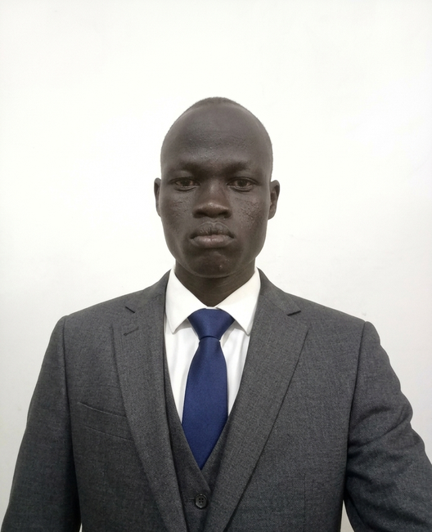
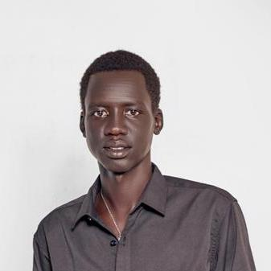
Team Members
Chan Gatwech — Founder & Project Lead
Gatduel Riek— Technical and Training Co-ordinator

Slide 15



Thank you!
Gmail: changatwech8@gmail.com
Phone: 0113482233
17

